Slide 1
MOVIE
RECOMMENDATION
SYSTEM
​

Slide 2
Break out 2
Vivek
Ankit
Supriya
Krishnakumar
Gaurav Shrivastava
Sanjeet
Lakhan

Slide 3
AGENDA
Introduction
Objective
Need of project
Types of recommendation system
Data Visualization
Conclusion
​

Slide 4
Introduction
We are going to build a movie recommendation system where recommendation system is nothing but Recommender systems are machine learning systems that help users discover new product and services. Every time you shop online, a recommendation system is guiding you towards the most likely product you might purchase.
Some examples of recommender systems in action include product recommendations on Amazon, Netflix suggestions for movies and TV shows in your feed, recommended videos on YouTube, music on Spotify, the Facebook newsfeed and Google Ads.

Slide 5
Dataset link:
We have downloaded this data set from Kaggle And here is the
link of it:
https://www.kaggle.com/datasets/ritayandhara/tmdb-dataset?select=TMDB_7000_Top_Rated_Movies.csv
and
https://www.kaggle.com/datasets/ritayandhara/tmdb-dataset?select=TMDB_10000_Popular_Movies.csv

Slide 6
Objective
To suggest movies based on the Content and Popularity

Slide 7
Need of project
Recommending the appropriate movie to the user by the both content based and popularity based.
So that they can prefer that movie which they want without wasting time.

Slide 8
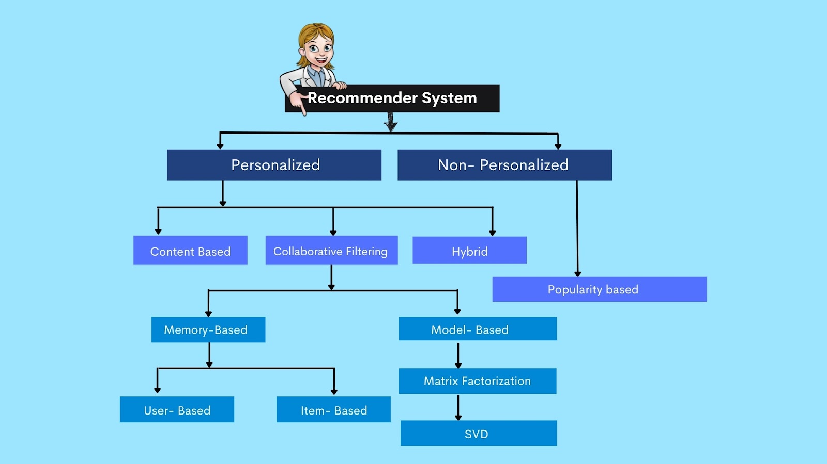
Types of recommendation system

Slide 9
CONTENT BASED RECOMMENDATION SYSTEM
They suggest similar items based on a particular item. This system uses item metadata, such as genre, director, description, actors, etc. for movies, to make these recommendations. The general idea behind these recommender systems is that if a person liked a particular item, he or she will also like an item that is similar to it.

Slide 10
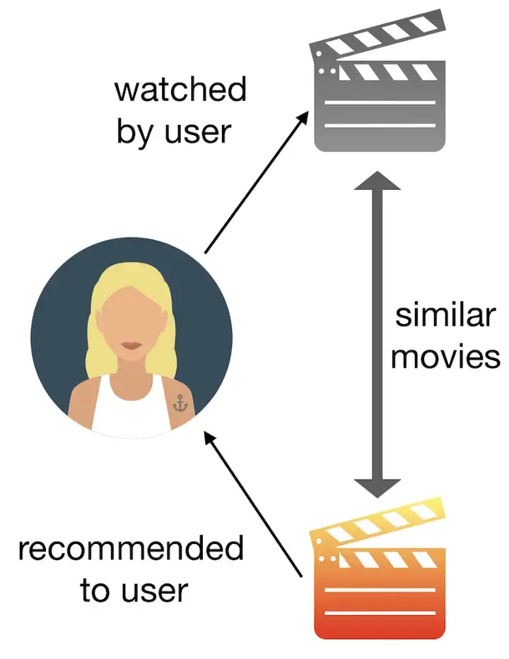
CONTENT BASED RECOMMENDATION

Slide 11
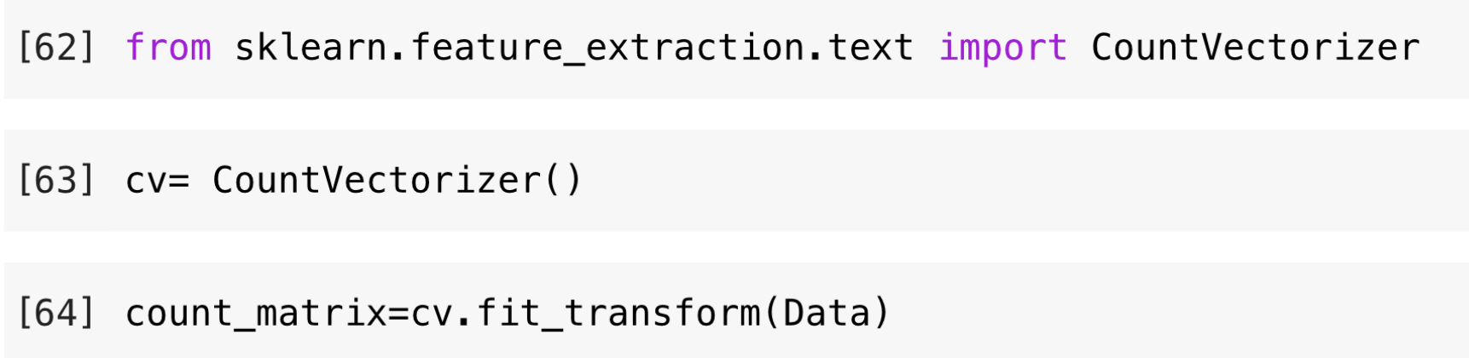
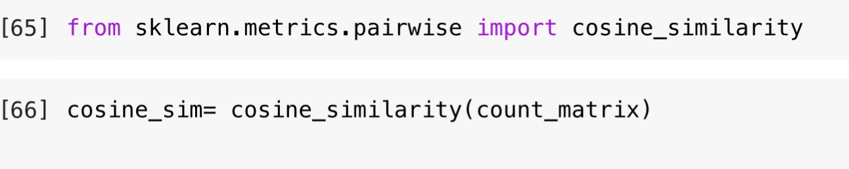
Code of content based recommendation

Slide 12
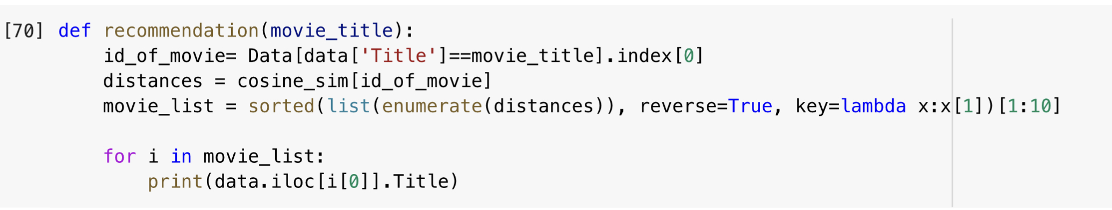
Code for recommendation

Slide 13
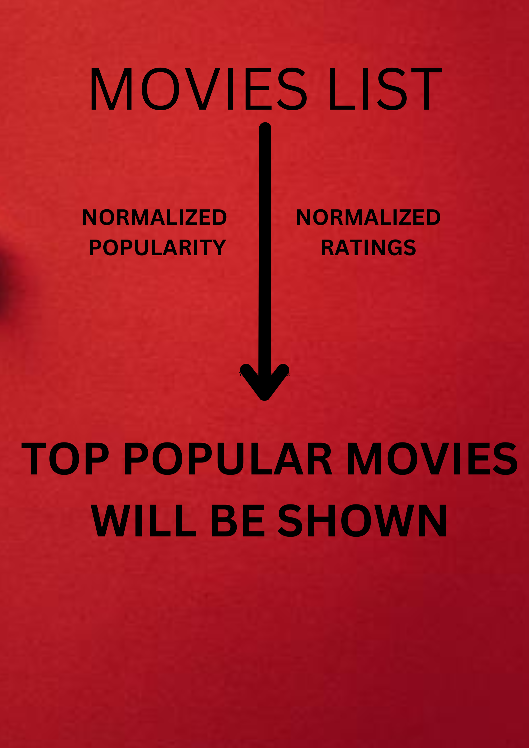
Popularity based recommendation
In this part we are going to find the most popular movies and recommend them to users. This can be useful for new user who don't know anything about the movies.

Slide 14
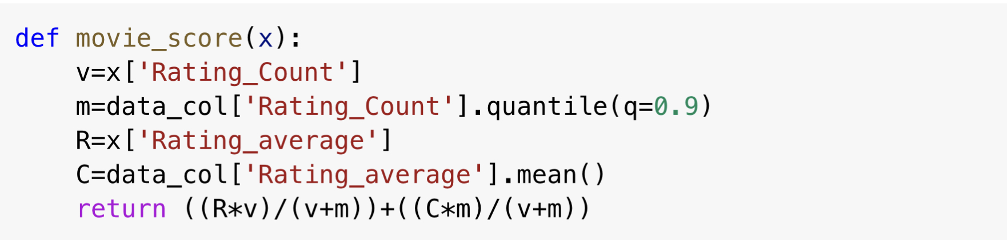
Popularity based recommendation

Slide 15
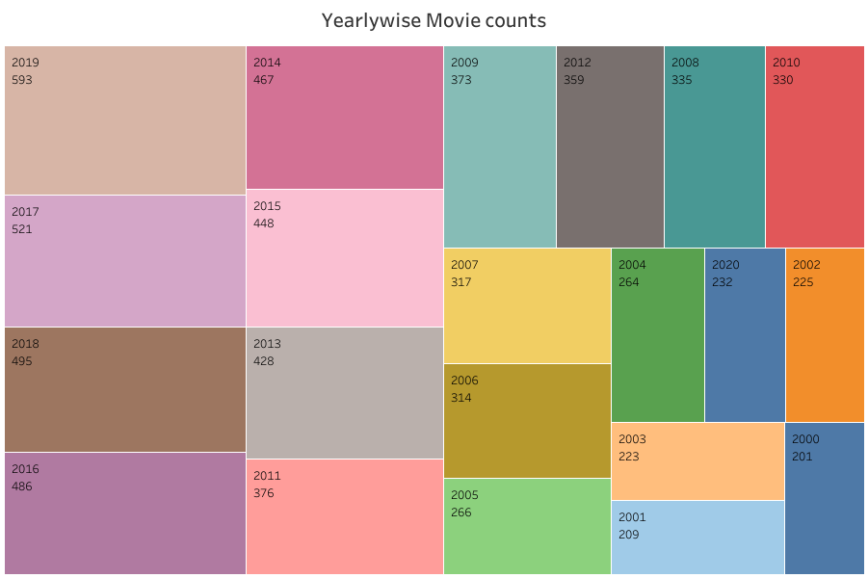
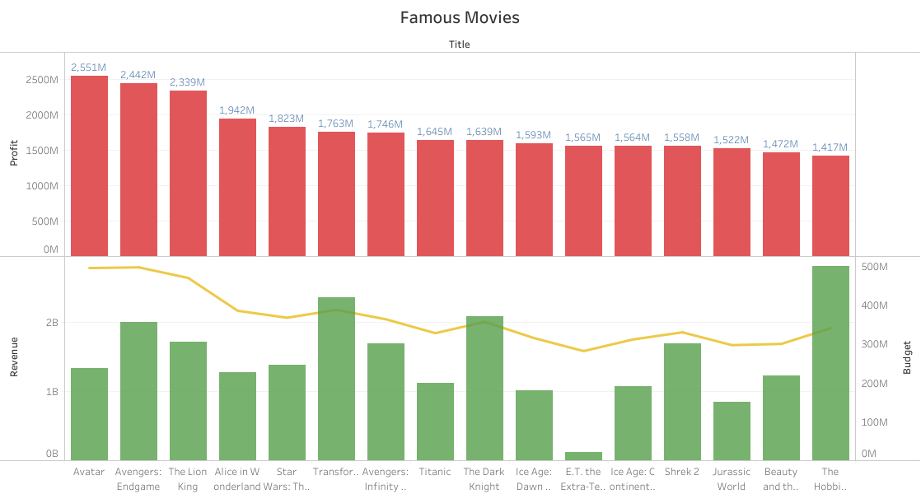

Slide 16
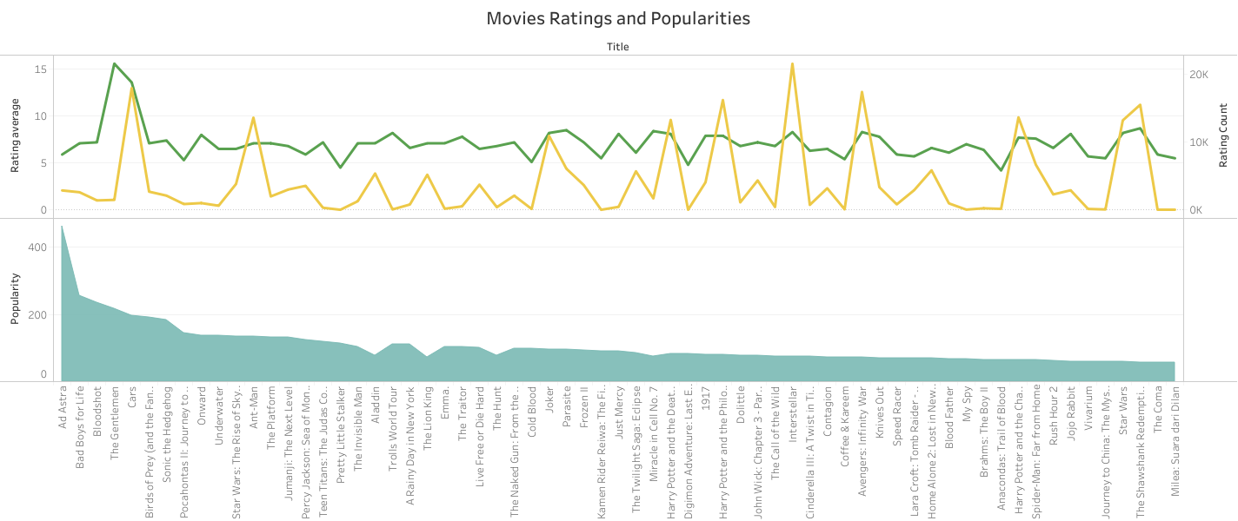

Slide 17
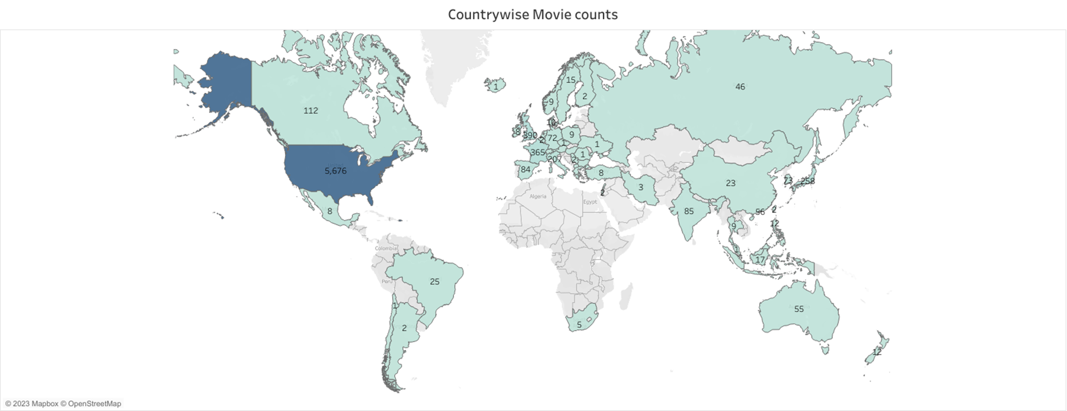

Slide 18
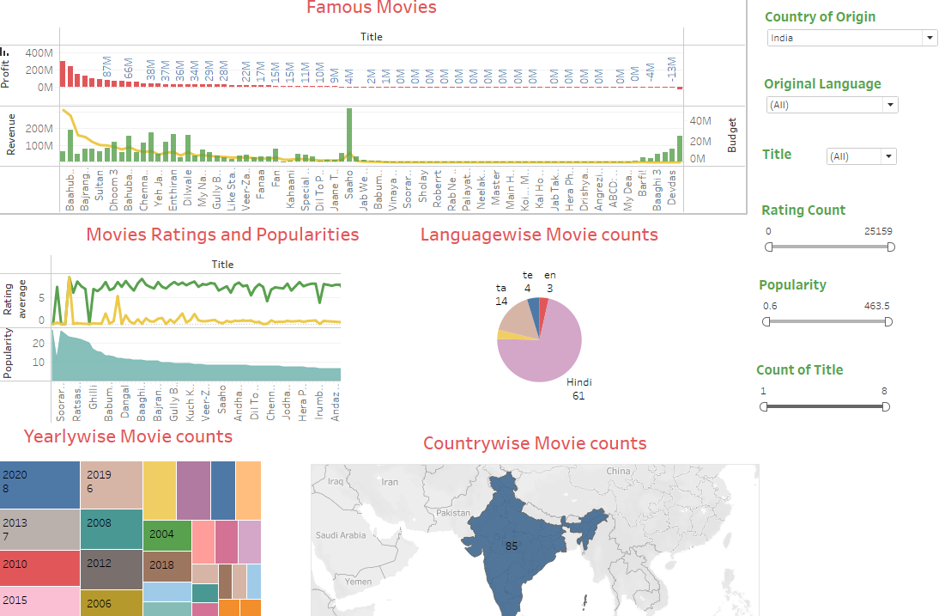

Slide 19
Conclusion
We created two types of recommendation systems based on CONTENT and POPULARITY
Content Based : We are getting a list of recommended movies related to the previously watched movie based on the content
Popularity Based : Top 10 movies are recommended to the user based on the popularity and ratings.

